Slide 1
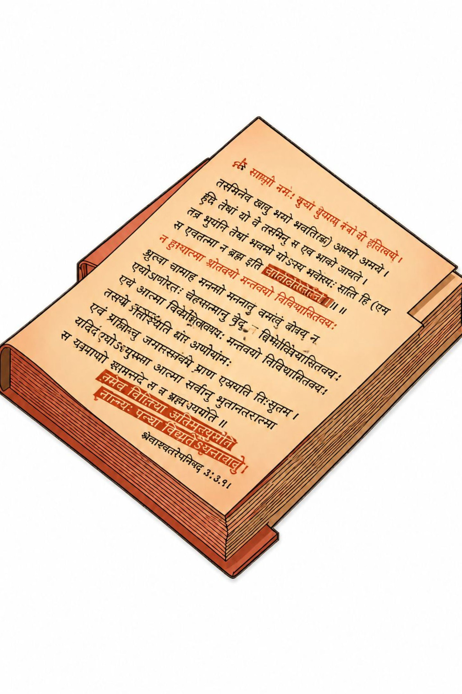
Morphological Analysis for
Indian Languages
Presented by C Anu keerthana(192472057)

Slide 2
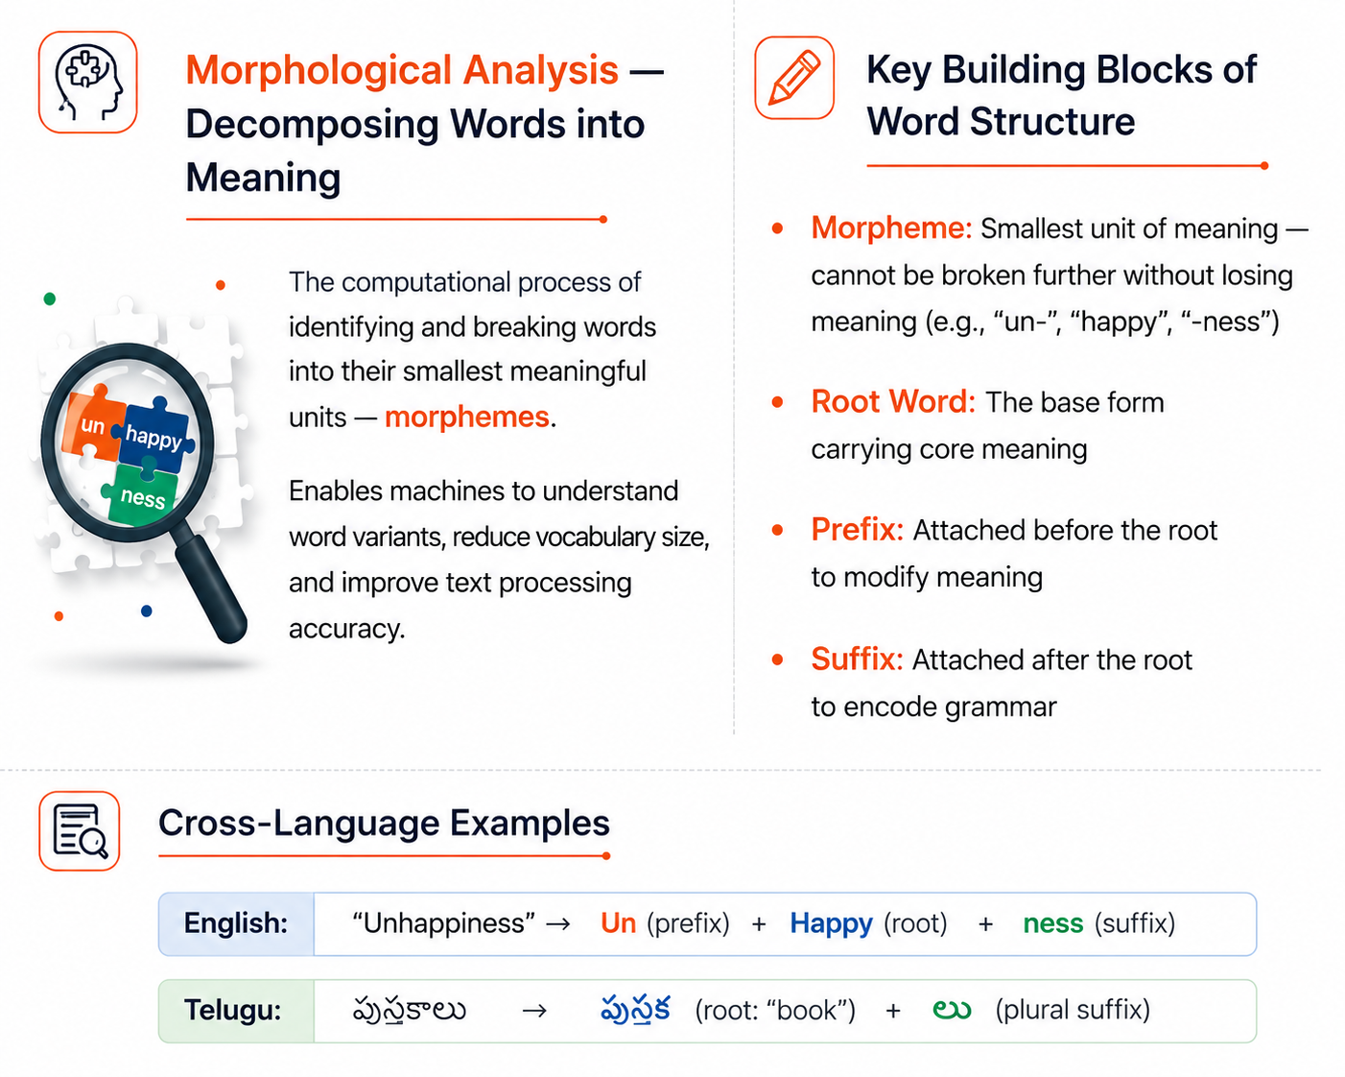
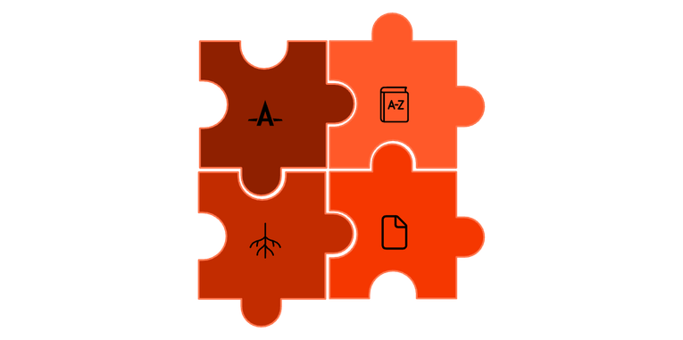
Introduction to Morphological Analysis
Word Structure Decomposition
Prefix
Example
Root
Suffix
A single root word can yield dozens of valid surface forms when combined with different morphemes — making morphological analysis essential for any NLP pipeline.

Slide 3
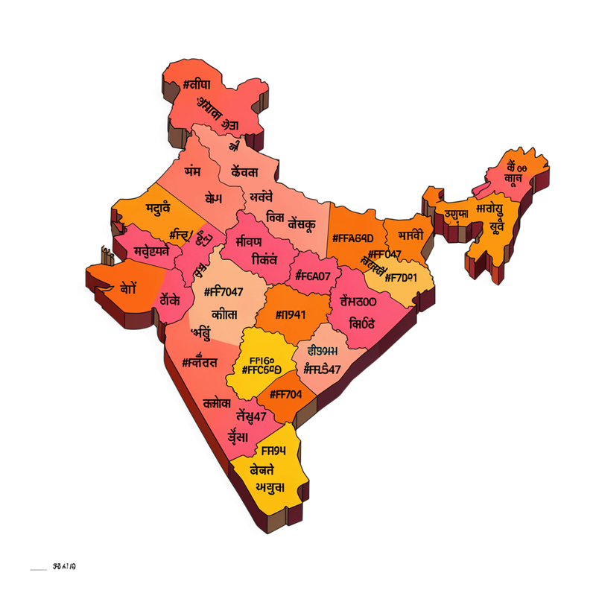

Morphological Richness of Indian Languages
Agglutinative Nature — The Core Challenge
Indian Language Regions
Indian languages like Telugu, Tamil, and Kannada attach multiple suffixes to a single root, encoding complex grammatical information — Gender, Number, Person, Tense, Case, and Mood — often within a single word form.
Hindi Inflection
लड़का (boy) → लड़के (boys, nominative) → लड़कों (boys, oblique case)
Telugu Inflection
విద్యార్థి (student) → విద్యార్థులు (students) → విద్యార్థులకు (to the students)
Tamil Inflection
மரம் (tree) → மரங்கள் (trees) — nasal insertion + plural suffix
A single root can generate hundreds of valid word forms — making morphological analysis essential for any Indian language NLP system.

Slide 4
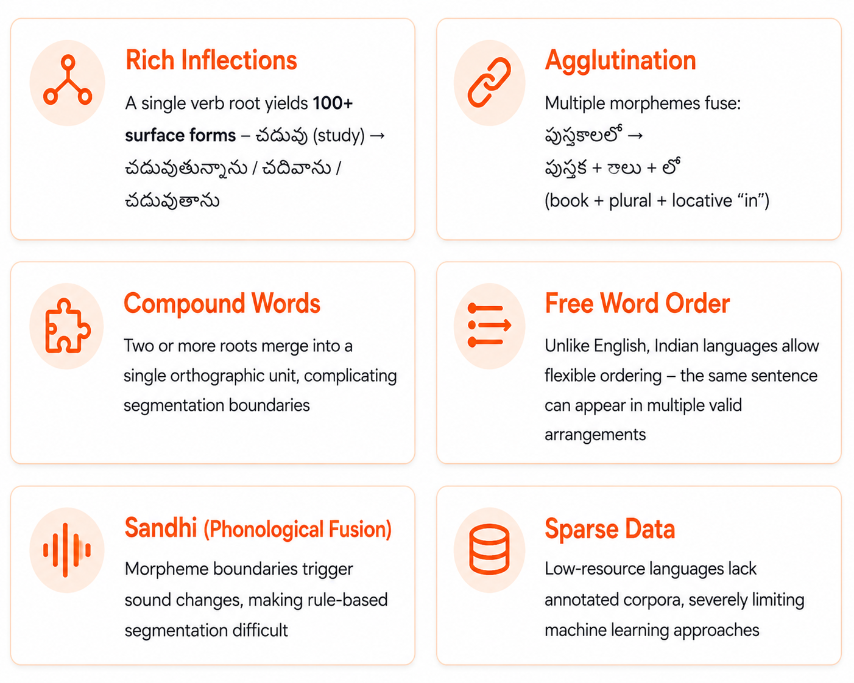

Challenges in Morphological Analysis
Word Decomposition Pipeline
Input Word
Tokenization
Morpheme Segmentation
POS Tagging
Structured Output

Slide 5




Techniques Used in Morphological Analysis
Five major paradigms power morphological analysis systems for Indian languages — ranging from hand-crafted linguistic rules to state-of-the-art transformer architectures.
Model Architecture Evolution
Technique
Accuracy
Scalability
Data Needed
Best For
Rule-Based FSTs
Finite-state transducers with hand-crafted grammar rules
Rule-Based
High
Low
None
Well-resourced languages
Dictionary-Based
Medium
Medium
Lexicon
Closed-domain tasks
Statistical ML (CRF/SVM)
Trained on annotated Indian language corpora
Machine Learning
High
High
Annotated corpus
General NLP tasks
Deep Learning
Very High
High
Large corpus
Complex morphology
Transformers (MuRIL/IndicBERT)
Pre-trained on multilingual data — state-of-the-art
Transformers (IndicBERT/MuRIL)
SOTA
Very High
Multilingual data
Cross-lingual tasks

Slide 6
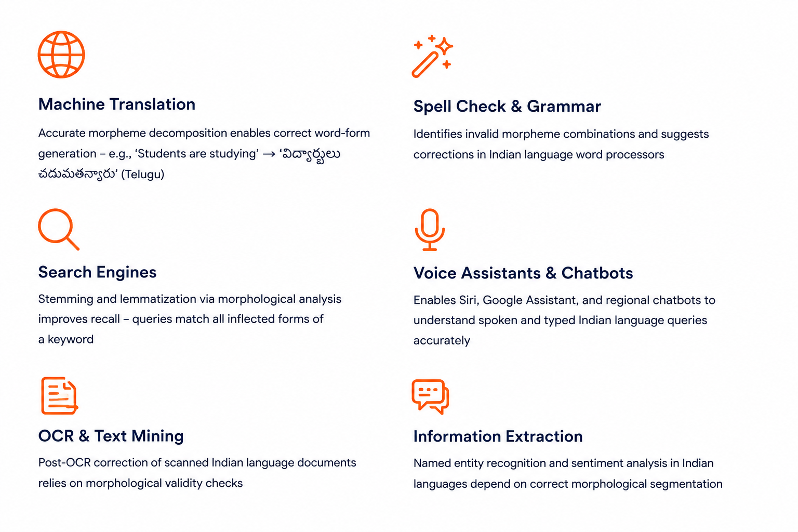






Applications of Morphological Analysis

Slide 7
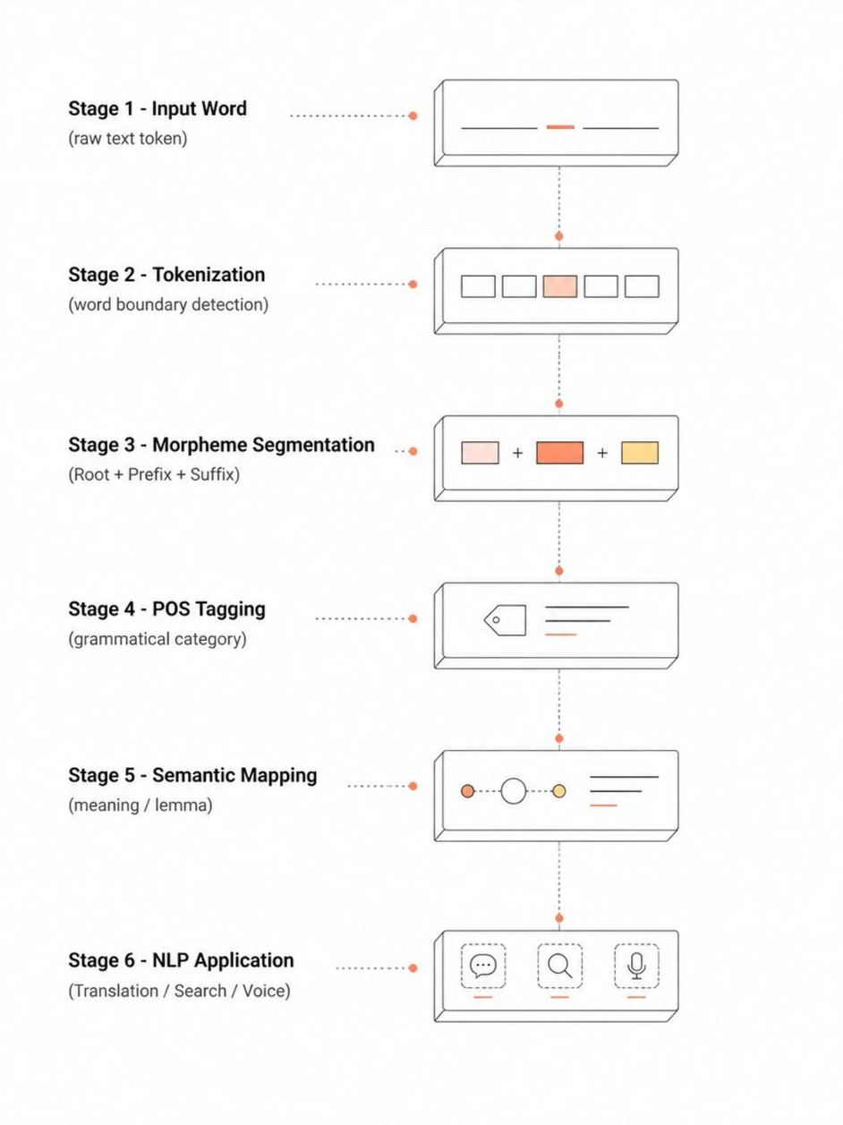
NLP Morphological Analysis Pipeline
Conclusion
Morphological Analysis identifies root words and grammatical variations in natural language text.
Indian languages require advanced analysis because they contain complex word structures.
It improves machine translation, spell checking, and information retrieval accuracy effectively.
Multiple techniques including rule-based and AI models enhance morphological processing performance.
Modern NLP models support accurate understanding of diverse Indian language variations effectively.
Morphological Analysis strengthens intelligent language applications and improves human-computer communication.

Slide 8
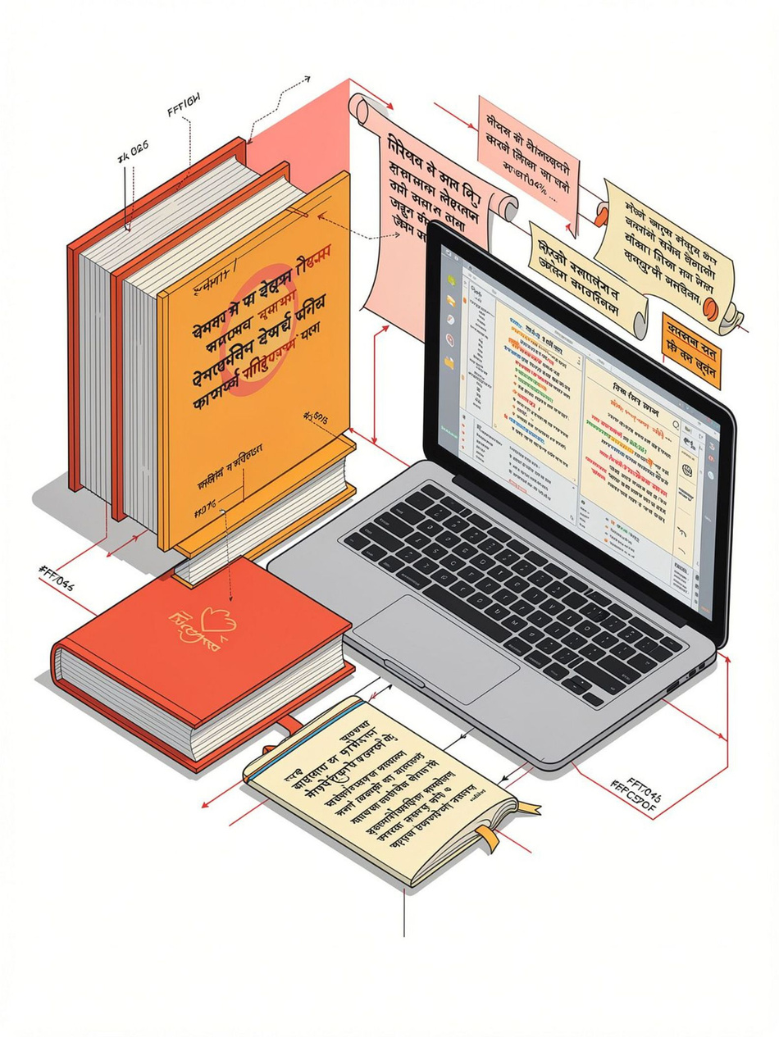

Thank You..!

